Slide 1
Careers in Data
By Julio Orellana
May 7, 2024

Slide 2
Table Of Content
3 Data Analyst Project Manager
1 Introduction
2 Job Roles
4 Business Analyst
5 Data Scientist
6 Data Visualization engineer
7 Software Developer
8 Conclusion

Slide 3
INTRODUCTION
1
Data Visualization is a robust and diverse skill that is need in many careers lets dive into some information about data visualization and look at some job roles that require it!

Slide 4
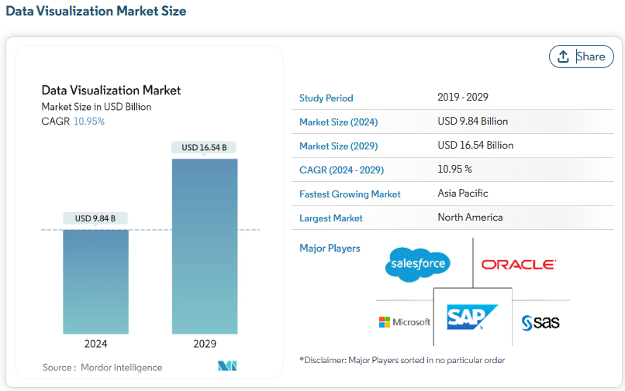
Data in the job industry
With our modern society advancing ever so much! We now see an increased demand in data processing needed.
This increase has been a positive and has shown a 10.95% in CAGR (Compound Annual Growth Rate). [1]
The market is also estimated to grow to 16.54 Billion. [1]

Slide 5
Job ROLES
2

Slide 6

Jobs for data visualization?
Data Analyst Project Manager
Business Analyst
Data Scientist
Data Visualization Engineer
Software Developer
This Photo by Unknown Author is licensed under CC BY-SA-NC

Slide 7
Data Analyst project manager
3

Slide 8

Job Responsibilities
As a Data Analyst Project Manager, you are responsible for leading data visualization efforts across the company.
These efforts and responsibility include :
Providing coaching on data visualization tools
Knowledge-sharing
Setting documentation code & standards
Maintaining documentation
Managing and processing “Big Data”
Monitoring and reporting on usage as needed
Perform analysis and interpretation
Develops actionable insights and recommendations

Slide 9
Skills and knowledge
Required and preferred skills for the job are the following:
Bachelor's degree in a related field or equivalent work experience
Project management skills
Statistical and data analytics experience
Predictive modeling with tools such as SQL, R, Python, Excel, Hadoop, SAS, SPSS, Geo-spatial tools, and others to perform analysis and interpret data
Collaboration
Process development
Marketing
Problem-solving.

Slide 10
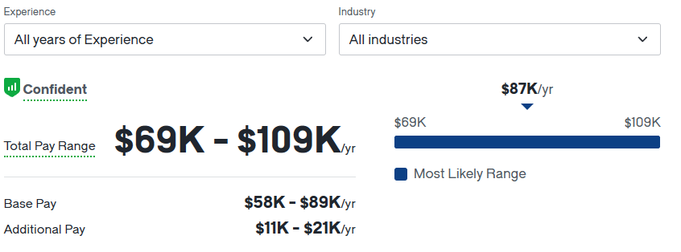
Pay range & locating roles
What is the pay range?
The pay range can differ due to state and region.
The pay can range from $69k-$109k according to Glassdoor.com
Where to find Data Analyst Project Manager roles?
Technology companies
Data companies
Financial Institutions
Any business involved in “Big Data”

Slide 11
Business Analyst
4

Slide 12
Job Responsibilities
A Business Analyst’s duties are to help create and develop data strategies and a data culture that helps accelerate business decision for the company.
A business analyst needs to be able to use data-driven insights by identify opportunities where data analytics can be leveraged to enhance decision-making processes by engaging with clients and identify key variables to develop predictions and logical results that address critical business questions.
Perform advanced data analysis through various datasets with BI tools (Power Bl & Tableau) to visualize and interpret results effectively.

Slide 13
Skills and knowledge
Required and preferred skills for the job are the following:
Bachelor's degree in data science, Statistics, Computer Science or a related data centric-technical field
Expert in using data visualization tools such as Tableau, Power Bl
Experience with cloud computing data platforms such as Azure, AWS, etc...
Data extraction methodologies
Experience with SQL
Data analysis
Problem-solving
Time management
Financial knowledge

Slide 14
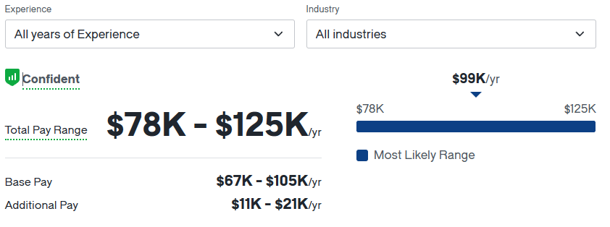
Pay range & locating roles
What is the pay range?
As we see the pay range can differ due to state, region and companies.
The pay can range from $78k-$125k according to Glassdoor.com
Where to find Business Analyst roles?
Technology companies
Consulting Firms
Financial Institutions
Healthcare

Slide 15
Data Scientist
5

Slide 16
Job Responsibilities
A Data Scientist is to be responsible for designing, processing and developing data sets, visualization, and data-driven solutions for your company.
Data Scientist conduct this by analyzing data in a format that can be presented to show data driven solutions.
A Data Scientist must also collaborate with team members to create data-driven solutions & visualizations that can be presented in a clear precise manner.
A data scientist must also be up to date on any advances in their technological field or programs.

Slide 17
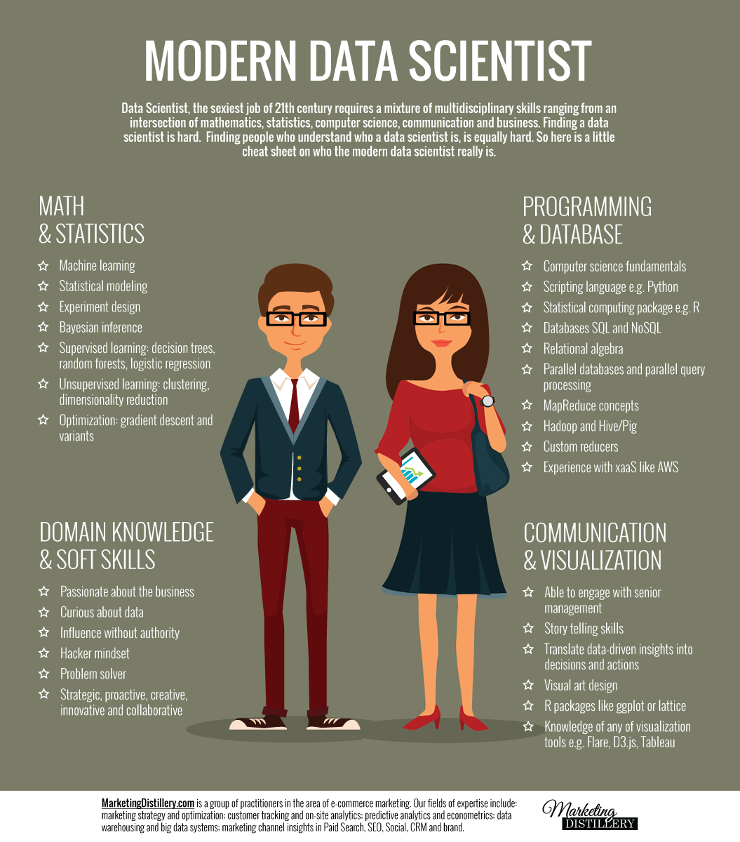
Skills and knowledge
The preferred skills and required skills are:
Bachelor's degree in computer science, mathematics, statistics, or a related field and/or experience.
Advanced knowledge of data analysis tools
Demonstrated experience with data visualization software.
This Photo by Unknown Author is licensed under CC BY-SA

Slide 18
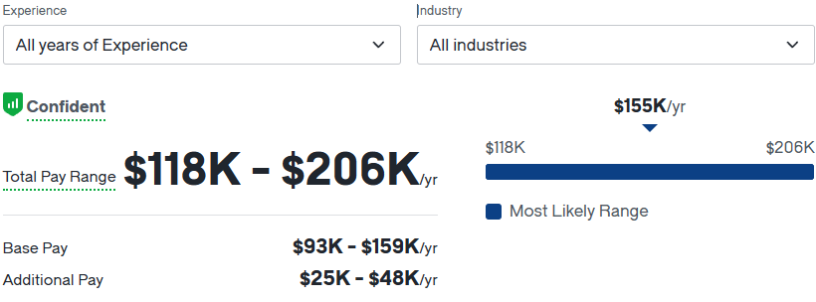
Pay range & locating roles
What is the pay range?
As we see again the pay range can differ due to state, region and companies.
The pay can range from $118k-$206k according to Glassdoor.com
Where to find Business Analyst roles?
Entertainment industry
Consulting Firms
Financial Institutions
Media

Slide 19
Data Visualization Engineer
6

Slide 20
Job Responsibilities
A Data Visualization Engineer’s main duties requires them to lead and specify on data visualization projects that they then present to management, clients or stakeholder.
As a data visualization engineer you need to be able to correct application of data granularity and aggregation from data - model into meaningful visualization.
Your duties also include analyzing, investigating, and surveying data to help process and create clear and precise visualization.

Slide 21
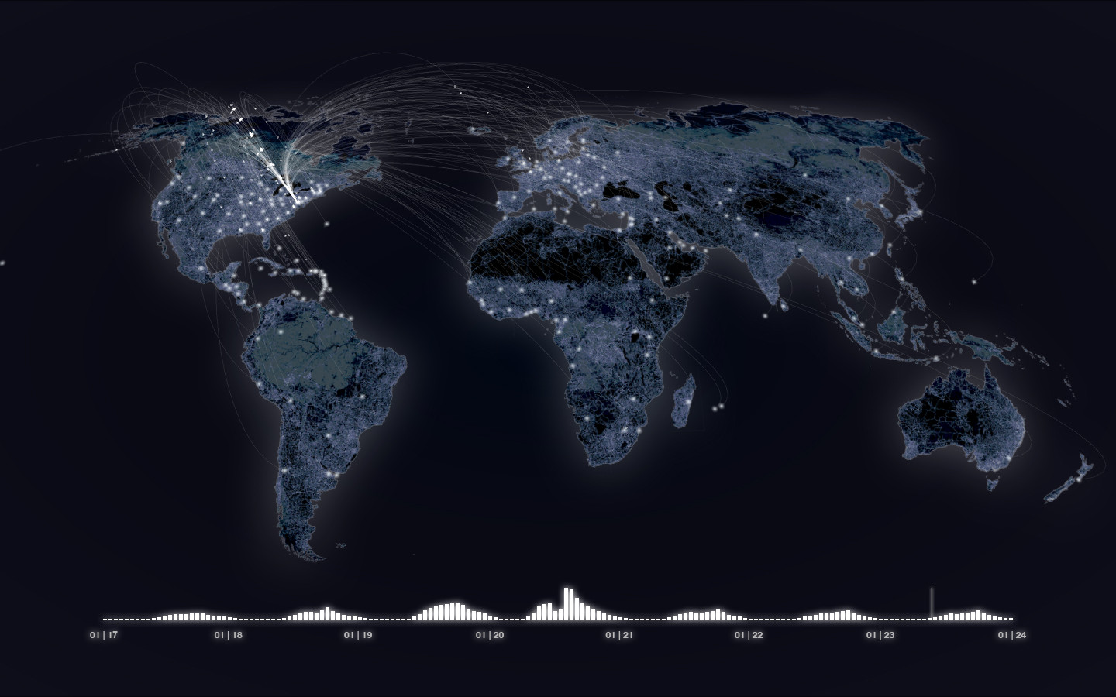
Skills and knowledge
Required and preferred skills for the job are the following:
Data visualization experience,
Knowledge on Power Bl or comparable products,
Server experience
Experience with large data sets
Defining best practices for data visualization.
This Photo by Unknown Author is licensed under CC BY-SA

Slide 22
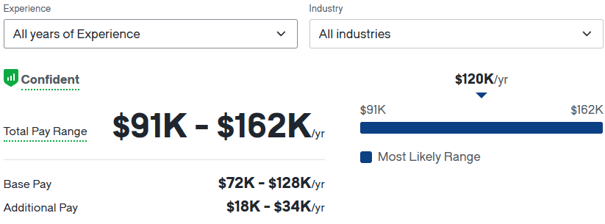
Pay range & locating roles
What is the pay range?
As we see again the pay range can differ due to state, region and companies.
The pay can range from $91k-$162k according to Glassdoor.com
Where to find Business Analyst roles?
Media
Marketing
Retail

Slide 23

Software developer
7

Slide 24
Job Responsibilities
As a software developer the main responsibilities one has are to help develop, design, build, and integrate software application for a company.
Moreover, these applications require the usage of web technologies and data technologies to conduct the development.
Data visualization knowledge in excel, Power BI, Tableau and R are recommended.
Provides great customer service and is adaptable.
Learns and quickly adapts to new business.

Slide 25
Skills and knowledge
Preferred and required skills are the following:
Bachelor's degree in computer science, Information Systems and/or 2 years of related work experience in data modeling and analytics.
2 years of hands-on experience with web, and/or server technologies using a combination of languages, including Node Js, NET Core, CSS, and C#.
Moreover, a minimum of 2 years in JavaScript development and experience in developing modern, fully responsive web apps using JS frameworks (Angular, Angular.JS).
Experience integrating RESTful APIs Experience writing database queries using SQL Experience integrating applications with data visualization tools like Power Bl, Power Apps, Qlik, etc.

Slide 26
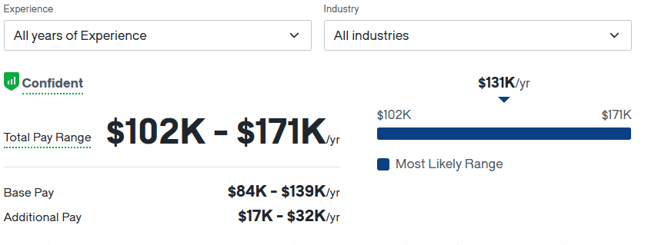
Pay range & locating roles
What is the pay range?
As we see again the pay range can differ due to state, region and companies.
The pay can range from $102k-$171k according to Glassdoor.com
Where to find Business Analyst roles?
Technology Industry
Financial Industry
Education
Marketing

Slide 27
Conclusion
8
As we have seen a variety of job roles require some form of data visualization and processing
Most importantly the use of the Data visualization technologies to help interpret the data and create a story and argument.
Also, we see that Data visualization happens to be an increasing job field and requirement in the CAGR.

Slide 28
Reflection
What I find most fascinating is the versatility and diverse use of data visualization. I honest feel like this skill will be a huge factor for whether I get approved for a job or rejected.
Data Visualization my eyes to the different avenues and roles one may take and pursue even after college.
Personally, I believe my interest in Data has only grown and my curiosity has reached a peak to where no amount of information could sate the hunger, I must learn more!
After doing this research, the most appealing role has been the Data Scientist role. Primarily for the job title as I think it is so cool. However, my interest also genuinely lies in the responsibilities and day to day operations a data scientist goes through. Also, the Pay looks amazing!

